Slide 1
Lecture [9][1] Strings
Dr. Siming Liu

Slide 2
Mid-term[1]
On 11/9
Tuesday 11/7 Review in class
TFs Additional Review Session
Tuesday 11/7 Orvis Building 204
6:30pm - 8:30pm.

Slide 3
quiz: pointers and functions
C function that takes as arguments two pointers to chars, it does not need to return anything. This function should swap the values pointed to by the pointers:
Write the prototype for this function
Write the function
If we have the following variables declared:
char a = ‘v’, b = ‘t’;
Write a line of code to swap these chars using your function.

Slide 4
Strings

Slide 5
Introduction
Strings are arrays of characters terminated by a null character ‘\0’
string constants (or literals in the C standard) and
string variables
The C library provides a collection of functions for working with strings.

Slide 6
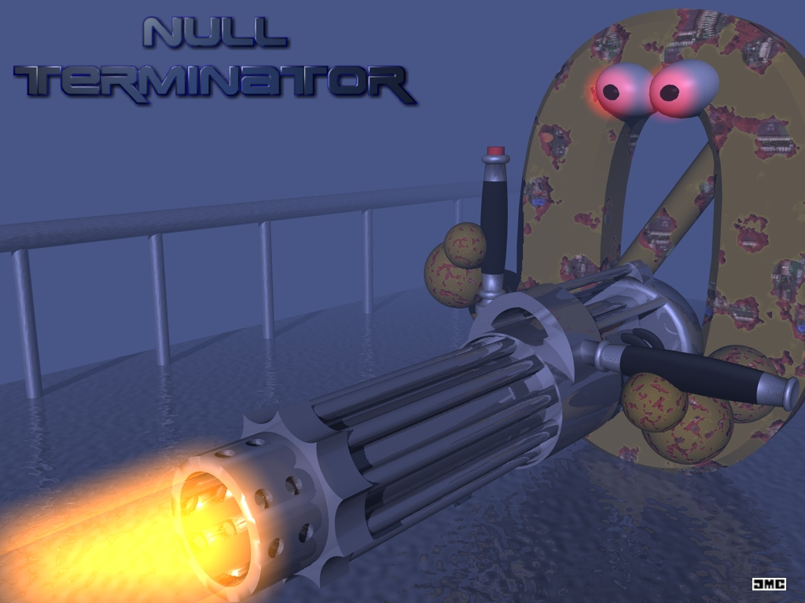

Slide 7
String Literals
A sequence of characters enclosed within double quotes:
"When you come to a fork in the road, take it.”
String literals may contain escape sequences.
"Candy\nIs dandy\nBut liquor\nIs quicker.\n --Ogden Nash\n"
causes the cursor to advance to the next line:
Candy
Is dandy
But liquor
Is quicker.
--Ogden Nash

Slide 8
Continuing a String Literal
The backslash character (\) can be used to continue a string literal from one line to the next:
printf("When you come to a fork in the road, take it. \
--Yogi Berra");
In general, the \ character can be used to join two or more lines of a program into a single line.

Slide 9
Continuing a String Literal
A better way:
printf("When you come to a fork in the road, take it."
"--Yogi Berra");
When two or more string literals are adjacent, the compiler will join them into a single string.

Slide 10
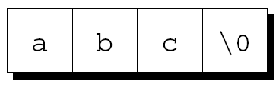

How String Literals Are Stored
A string literal of length n will need n + 1 bytes of memory
the n characters in the string, plus
the null character to mark the end of the string.
The null character is a byte whose bits are all zero
it is represented by the ‘\0’ escape sequence.
String literal “abc”
Empty string “”

Slide 11
How String Literals Are Stored
String literals are stored as an array, the compiler treats it as a pointer of type char *.
Both printf and scanf expect a value of type char * as their first argument.
printf("abc");
passes the address of "abc" (a pointer to where the letter a is stored in memory)

Slide 12
Operations on String Literals
We can use a string literal wherever C allows a char * pointer:
char *p;
p = "abc";
This assignment makes p point to the first character of the string.

Slide 13
Operations on String Literals
String literals can be subscripted:
char ch;
ch = "abc"[1]; //ch will be b
Convert a number between 0 and 15 into the equivalent hex digit:
char digit_to_hex_char(int digit)
{
return "0123456789ABCDEF"[digit];
}

Slide 14

Operations on String Literals
Attempting to modify a string literal causes undefined behavior:
char *p = "abc”;
*p = 'd'; /*** WRONG ***/
A program that tries to change a string literal may crash or behave erratically.

Slide 15
String Literals versus Character Constants
A string literal containing a single character is not the same as a character constant.
"a" is represented by a pointer.
'a' is represented by an integer.
A legal call of printf:
printf("\n");
An illegal call:
printf('\n'); /*** WRONG ***/

Slide 16
String Variables
Any one-dimensional array of characters can be used to store a string.
A string must be terminated by a null character.
Difficulties with this approach:
It can be hard to tell whether an array of characters is being used as a string.
String-handling functions must be careful to deal properly with the null character.
Finding the length of a string requires searching for the null character.

Slide 17
String Variables
If a string variable needs to hold 80 characters, it must be declared to have length 81 (for the null character):
#define STR_LEN 80
…
char str[STR_LEN+1];
Defining a macro that represents 80 and then adding 1 separately is a common practice.

Slide 18
String Variables
Be sure to leave room for the null character when declaring a string variable.
Failing to do so may cause unpredictable results when the program is executed.
The actual length of a string depends on the position of the terminating null character.
An array of STR_LEN + 1 characters can hold strings with lengths between 0 and STR_LEN.

Slide 19
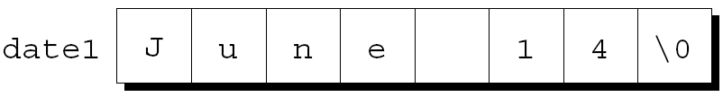
Initializing a String Variable
A string variable can be initialized at the same time it is declared:
char date1[8] = "June 14";
The compiler will automatically add a null character so that date1 can be used as a string:
"June 14" is not a string literal in this context.
Instead, C views it as an abbreviation for an array initializer.

Slide 20
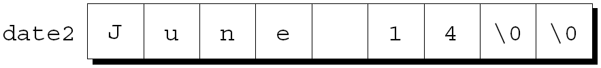
Initializing a String Variable
If the initializer is too short to fill the string variable, the compiler adds extra null characters:
char date2[9] = "June 14";
Appearance of date2:

Slide 21
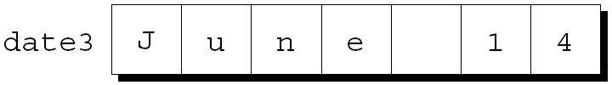
Initializing a String Variable
An initializer for a string variable cannot be longer than the variable, but it can be the same length:
char date3[7] = "June 14";
There is no room for the null character, so the compiler makes no attempt to store one:

Slide 22
Initializing a String Variable
The declaration of a string variable may omit its length, in which case the compiler computes it:
char date4[] = "June 14";
The compiler sets aside eight characters for date4 plus a null character.
Useful if the initializer is long, since computing the length by hand is error-prone.

Slide 23
Character Arrays versus Character Pointers
The declaration
char date[] = "June 14";
declares date to be an array,
The similar-looking
char *date = "June 14";
declares date to be a pointer.
Thanks to the close relationship between arrays and pointers, either version can be used as a string.

Slide 24
Character Arrays versus Character Pointers
char date[] = "June 14";
char *date = "June 14”;
date is an array name
the characters stored in date can be modified
date is a variable that can point to other strings
date points to a string literal that should not be modified

Slide 25
Character Arrays versus Character Pointers
char *p; // does not allocate space
// for a string.
Before we can use p as a string, it must point to an array of characters:
char str[STR_LEN+1], *p;
p = str; // p points to a string variable
Another possibility is to make p point to a dynamically allocated string.

Slide 26
Character Arrays versus Character Pointers
Using an uninitialized pointer variable as a string is a serious error.
An attempt at building the string "abc":
char *p;
p[0] = 'a'; /*** WRONG ***/
p[1] = 'b'; /*** WRONG ***/
p[2] = 'c'; /*** WRONG ***/
p[3] = '\0'; /*** WRONG ***/
Since p has not been initialized, this causes undefined behavior.

Slide 27
Reading and writing strings

Slide 28
Reading and Writing Strings
Writing a string: use printf or puts
Reading a string: use either scanf or gets
Attention: the input may be longer than the string variable into which it is being stored.
Alternative: we can read strings one character at a time.

Slide 29
Writing Strings Using printf
Use %s conversion specification with printf :
char str[] = "Are we having fun yet?";
printf("%s\n", str);
The output will be:
Are we having fun yet?
printf writes the characters in a string one by one until it encounters a null character.

Slide 30
Writing Strings Using printf
To print part of a string, use the conversion specification %.ps
p is the number of characters to be displayed.
The statement
char str[] = "Are we having fun yet?";
printf("%.6s\n", str);
will print:
Are we

Slide 31
Writing Strings Using printf
The %ms conversion will display a string in a field of size m.
If the string has fewer than m characters, it will be right-justified within the field.
To force left justification instead, we can put a minus sign in front of m.
The conversion specification %m.ps causes the first p characters of a string to be displayed in a field of size m.

Slide 32
Writing Strings Using puts
char str[] = "Are we having fun yet?";
puts(str);
Will print:
Are we having fun yet?
… and advance to a new line
After writing a string, puts always writes an additional new-line character.

Slide 33
Reading Strings Using scanf
Use the %s conversion specification with scanf to read a string into a character array:
scanf("%s", str);
How does scanf work?
it skips white space, then
reads characters into str until it encounters a white-space character (or tab or new line).
always stores a null character at the end of the string.
str is treated as a pointer, no need to put the & operator in front of str.

Slide 34
Reading Strings Using gets
Use gets to read an entire line of input
Properties of gets:
Does not skip white space before starting to read input
Reads until it finds a new-line character
Discards the new-line character instead of storing it; the null character takes its place

Slide 35
Reading Strings Using scanf and gets
Consider the following program fragment:
char sentence[SENT_LEN+1];
printf("Enter a sentence:\n");
scanf("%s", sentence);
Suppose that after the prompt
Enter a sentence:
the user enters the line
To C, or not to C: that is the question.
scanf will store the string "To" in sentence.

Slide 36
Reading Strings Using scanf and gets
If we replace scanf by gets:
char sentence[SENT_LEN+1];
printf("Enter a sentence:\n");
gets(sentence);
When the user enters the same input as before, gets will store the string
” To C, or not to C: that is the question."
in sentence.

Slide 37
Reading Strings Using scanf and gets
scanf and gets have no way to detect when the string array is full.
may store characters past the end of the array, causing undefined behavior.
scanf can be made safer by using the conversion specification %ns instead of %s.
n is an integer indicating the maximum number of characters to be stored.
gets is inherently unsafe
fgets is a much better alternative.

Slide 38
Reading Strings Character by Character
Programmers often write their own input functions.
Issues to consider:
Should the function skip white space before beginning to store the string?
What character causes the function to stop reading: a new-line character, any white-space character, or some other character? Is this character stored in the string or discarded?
What should the function do if the input string is too long to store: discard the extra characters or leave them for the next input operation?

Slide 39
Reading Strings Character by Character
Suppose we need a function that
Does not skip white-space characters
Stops reading at the first new-line character (which is not stored in the string), and
Discards extra characters
Returns the number of characters stored in the string
A prototype for the function:
int read_line(char str[], int n);
If the input line contains more than n characters, read_line will discard the additional characters.

Slide 40
Reading Strings Character by Character
A while loop that calls getchar to read a character and then stores the character in str, provided that there is room left:
int read_line(char str[], int n)
{
int ch, i = 0;
while ((ch = getchar()) != '\n')
if (i < n)
str[i++] = ch;
str[i] = '\0'; /* terminates string */
return i; /* number of characters stored */
}
We must take care of this ourselves!!

Slide 41
Accessing the Characters in a String
Use subscripting, as with arrays:
int count_spaces(const char s[])
{
int count = 0, i;
for (i = 0; s[i] != '\0'; i++)
if (s[i] == ' ')
count++;
return count;
}

Slide 42
Accessing the Characters in a String
Same function, using pointer arithmetic instead:
int count_spaces(const char *s)
{
int count = 0;
for (; *s != '\0'; s++)
if (*s == ' ')
count++;
return count;
}

Slide 43
Accessing the Characters in a String
Is it better to use array operations or pointer operations to access the characters in a string?
We can use either or both. Traditionally, C programmers lean toward using pointer operations.
Should a string parameter be declared as an array or as a pointer?
There is no difference between the two.
Does the form of the parameter (s[] or *s) affect what can be supplied as an argument?
No.

Slide 44
String idioms

Slide 45
Searching for the End of a String
A function strlen that searches for the end of a string, using a variable to keep track of the string’s length:
size_t strlen(const char *s)
{
size_t n;
for (n = 0; *s != '\0'; s++)
n++;
return n;
}
size_t is an unsigned integer type of at least 16 bits

Slide 46
Searching for the End of a String
To condense the function, we can move the initialization of n to its declaration:
size_t strlen(const char *s)
{
size_t n = 0;
for (; *s != '\0'; s++)
n++;
return n;
}
same as *s != 0
same as *s

Slide 47
Searching for the End of a String
A version of strlen that uses these observations:
size_t strlen(const char *s)
{
size_t n = 0;
for (; *s; s++)
n++;
return n;
}
`
increment s and tests *s in the same expression

Slide 48
Searching for the End of a String
Increments s and tests *s in the same expression:
size_t strlen(const char *s)
{
size_t n = 0;
for (; *s++;)
n++;
return n;
}
Replacing the for statement with a while statement
size_t strlen(const char *s)
{
size_t n = 0;
while (*s++)
n++;
return n;
}

Slide 49
Searching for the End of a String
Although we condensed strlen quite a bit, we have not increased its speed.
A faster version, at least with some compilers:
size_t strlen(const char *s)
{
const char *p = s;
while (*s)
s++;
return s - p;
}
Here we increment a pointer instead of a variable

Slide 50
Readings
Chapters 11, 12
Chapter 13 (read ahead)

